Slide 1
Social appropriation of s&t: farmers involved in climate change science
Jenni Metcalfe
www.econnect.com.au
Notes:
Buenes tardes muchos gracias por la invitation estar aqui pero me espagne es non bueno so I will now speak in English. First let me give you a bit of background about myself...

Slide 2
Changing australian attitudes
Notes:
Some say that in 2007 we saw a change of government in Australia due to one government promising to act on climate change and the other virtually denying its existence.
Unfortunately, in the 3 years since that election, the sceptics have been very vocal and belief in climate change and the fact that it has been induced by humans has declined.
These are some figures showing the decline:
CC caused by humans: 52 (2007), 44 (2010)
CC serious/v serious threat: 75 (2007) 69 (2010)
CC not a threat: 21 (2007) 29 (2010)
Recently I presented a series of workshops on ‘Communicating the science of climate change’ to interested communicators, media people and NGOs. On the way to the fist workshop I asked my cab driver if he believed in climate change, and his response was “Oh no, I don’t get into politics”. I think this is where the debate on climate change has now fallen down – it has become a political rather than a science issue.
Today I want to talk to you the challenges faced by farmers in Australia dealing with climate change and variability, and some of the ways we are working with them to communicate more effectively about climate change science.

Slide 3
Denial of climate change
Strategic - those who deny climate change to protect their job, business, position, relationship
Intellectual – those with a genuine disagreement with climate change based on their own scientific understanding
Psychological – those who deny climate change because it challenges their beliefs and /or behaviours or because they emotionally can’t cope with the thought of climate change and its impacts
Source: http://www.psandman.com/col/climate.htm
Notes:
Peter Sandman, the US risk communication expert, believes many people deny climate change not from a rational basis, but because they can’t deal with it.

Slide 4
Climate
Comprehending farmers
Climate Kelpie
Climate Champions
Notes:
Today I want to look at communication with farmers that I have been involved with in the past couple of years and a couple of great ways we used to engage farmers in the science of climate change

Slide 5
comprehending farmers
Variable climate – Australia second only to Antarctica
Variable climate ‘masks’ climate change

Slide 6
Changes in climate
Observed changes in climate over last 10 years
Many rural people
had noticed
Less Rain
Increased
Variability
More extreme
weather events
Notes:
These are the results of a survey of WA farmers conducted by Chris Evans
School of Agriculture & Environment, Curtin University in 2008 – 411 farmers at field days – structured and semi structured interviews
To begin with I will give a brief summary of responses to climate change.
Firstly people were asked if they had noticed any changes in the climate over the last 10 years related to decreased rainfall, increased seasonal variability and more extreme weather events.
Most agreed that rainfall had decreased, variability increased and to lesser extent there had been more extreme weather events.
But here in lays the first problem for extension.
While most farmers recognised seasonal variability as a risk they were confident that they were managing it.
Many farmers from southern regions thought that the decrease in rainfall was a benefit because it had eased water logging issues and grain yields had improved as a result.
Finally extreme weather events although happening more often were not considered to be of any consequence for the majority of farmers.
So the three main climate change impacts that science has identified as risks for WA farmers were considered to be manageable, beneficial or of little consequence.

Slide 7
Is climate change occurring & is it natural (Not influenced by greenhouse emissions)
Believe climate
change is natural
Sceptical of human
induced climate change
Over half uncertain
if climate change is
occurring & if its natural
Climate change
is not natural
Accept human induced
climate change
Notes:
So then what did people think about climate change?
Just over a third thought that it was occurring and 13% didn’t think it was. A quarter believed that it wasn’t part of a natural climatic cycle and 21% believed it was and that it wasn’t being influenced by greenhouse emissions.
However over half were uncertain if it was occurring and if it was natural.

Slide 8
Climate change is a major threat to farm / business & communities future
Higher threat perception
than acceptance of human
induced climate change
Notes:
Despite the high levels of uncertainty and relatively low acceptance of climate change, 42% though it was a major threat to rural communities.
On the other hand only a third (33%) of farmers and businesses believed it represented a threat.

Slide 9
Change in practices
Notes:
But farmers are still prepared to change their practices
Source ABS 06-07
intensity of cropping and/or grazing activities (69.3%). The next most common alterations were changed watering/ irrigation practices (32.7%) and changed rotation or fallow practices (31.9%).

Slide 10
Where farmers like to get their information
Farmer groups/forums
Private, departmental and retail agronomists
Other farmers; nine out of 10 farmers are influenced by leading farmers to change
Research agencies

Slide 11
How do farmers like to get information
Regular updates
Direct personal engagement
Website
Rural radio
Rural weekly newspaper and farm journals articles
Electronic newsletter with brief summaries and web links

Slide 12
Reasons why farmers don’t use seasonal forecast information
Notes:
We’ve also found the farmers like information to be reliable and relevant to their region and commodity

Slide 13
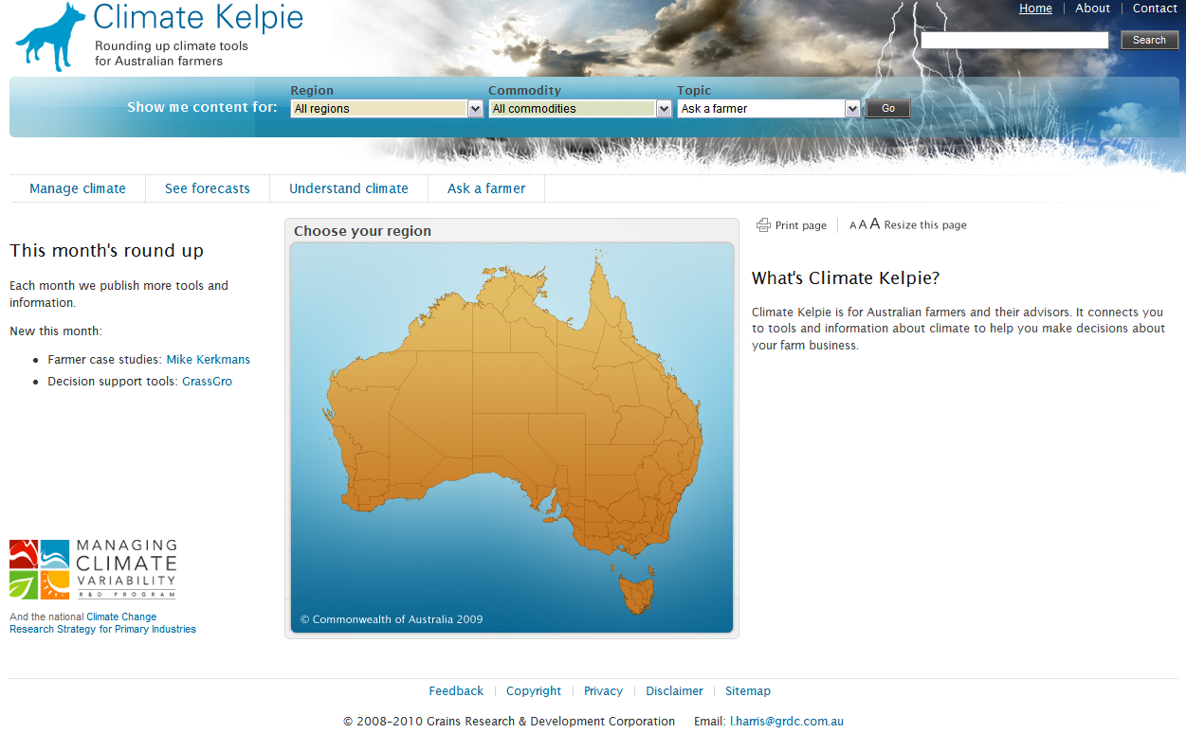
www.climatekelpie.com.au
Notes:
Let me tell you about Climate Kelpie, a one-stop shop site for farmers seeking climate information. A “kelpie” is an Australian dog that is used on many farms to round up sheep and cows. This site works like a kelpie to round up information and links for farmers.

Slide 14
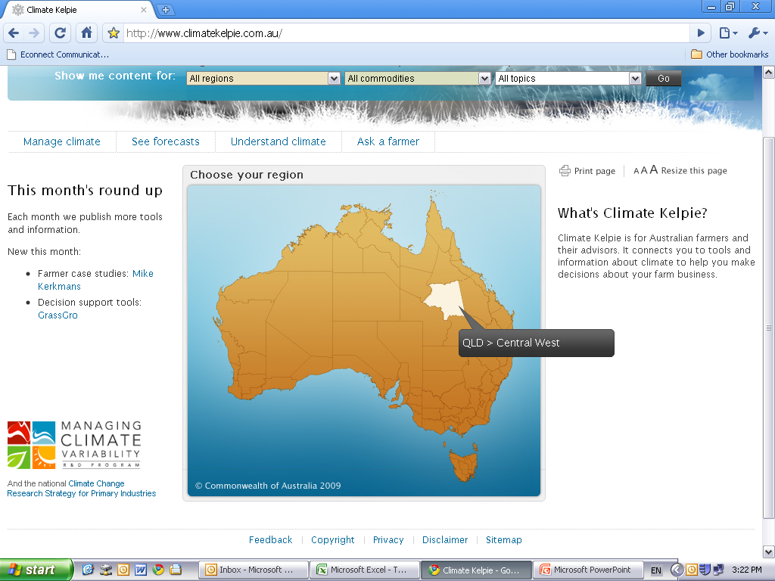
The interactive map shows different regions
Notes:
The site provides region specific information

Slide 15
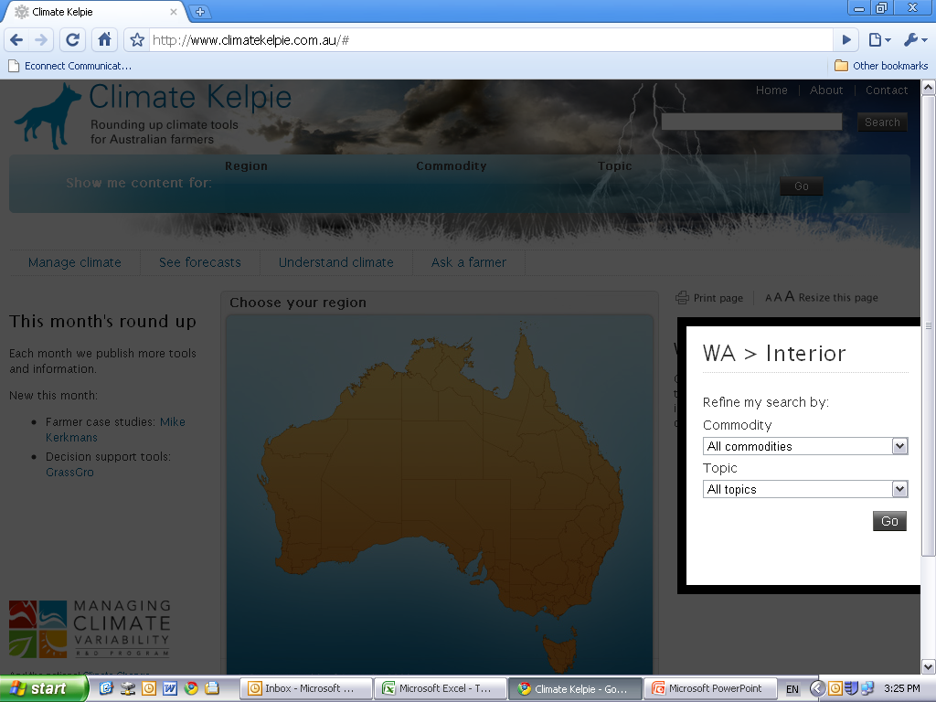
Then refine your search for information by commodity or topic.
.
Notes:
You can also filter the information by your commodity or topic

Slide 16
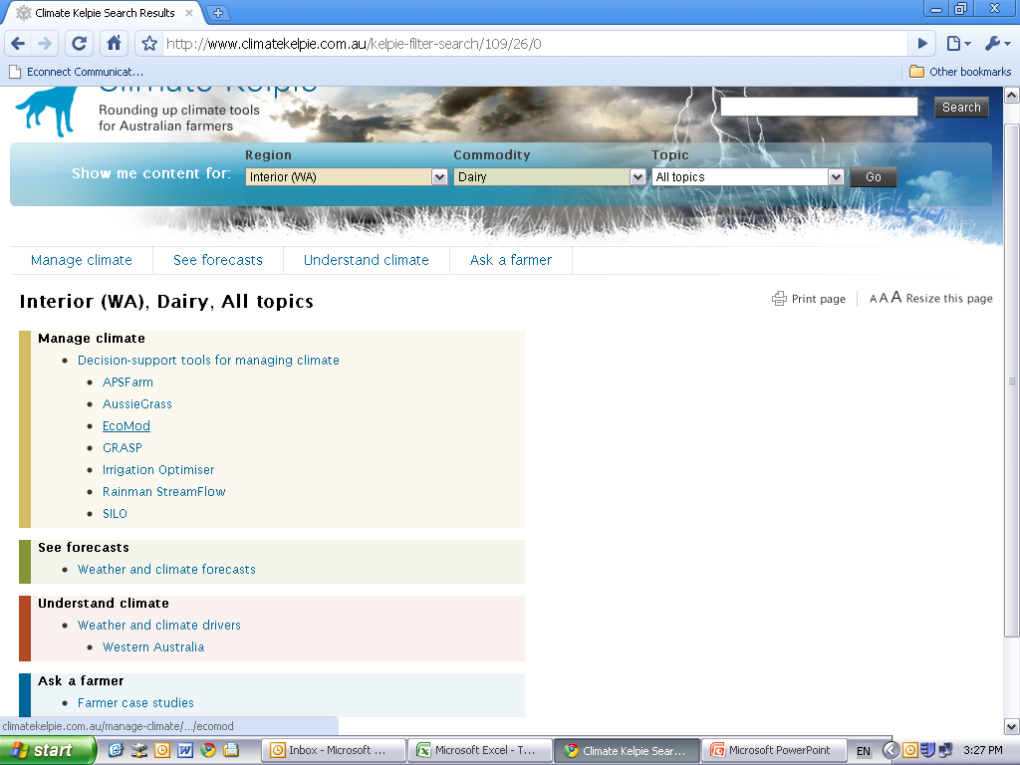
pick a region and commodity
…in this case Interior western australia, dairy, all topics.
.
Tools for ‘Managing climate’ on dairy farms in Interior WA
Forecasts and weather information
Links to understanding climate drivers for Interior WA
Farmer case studies for Interior WA
Notes:
This is an example of what you get if you filter information by a region and a industry

Slide 17
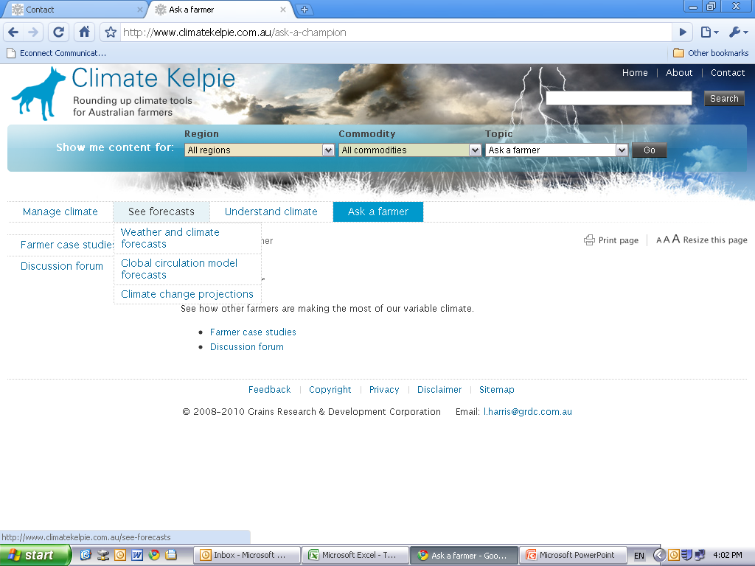
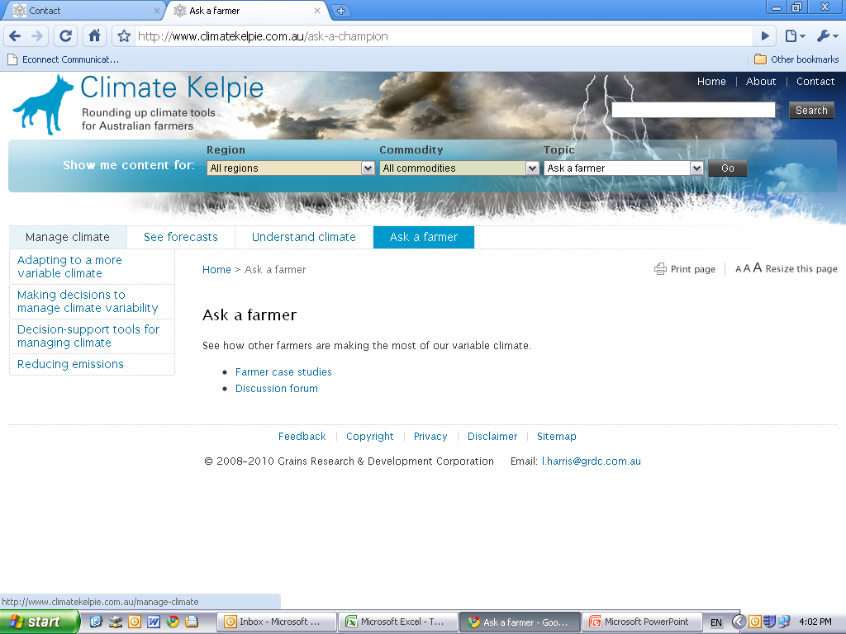
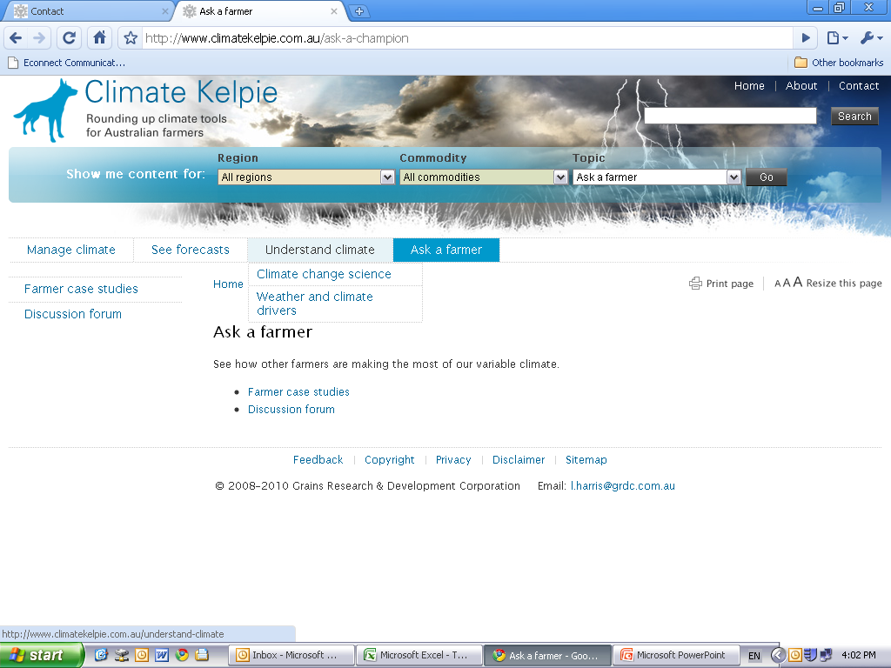
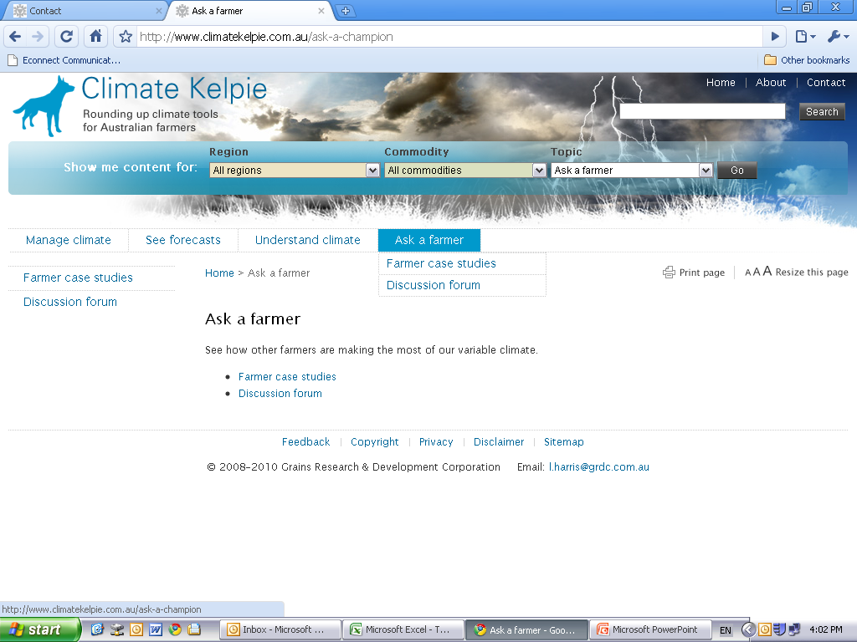
These are the subheadings available under each:
Notes:
These are the four main topics on the site

Slide 18
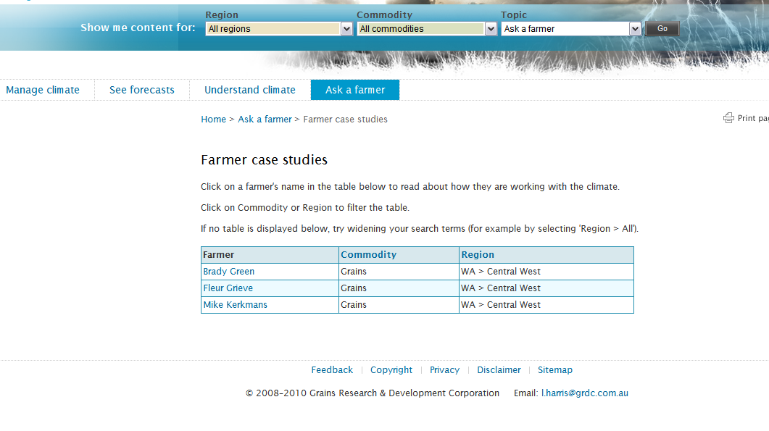
Farmer case studies
Notes:
We also include farmer case studies from different parts of Australia

Slide 19
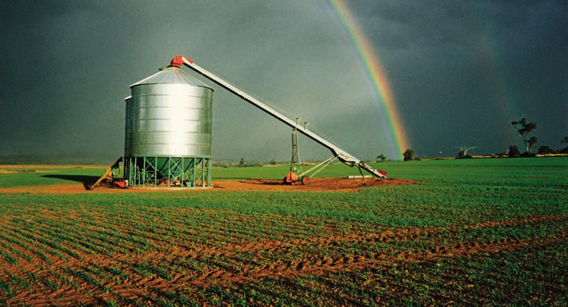
ClimatE Champions program
Notes:
Another program is the Climate Champion program. This is the program I am most excited about because it involved farmers talking to farmers. These farmers’ climate stories will also appear on the Climate Kelpie website.

Slide 20
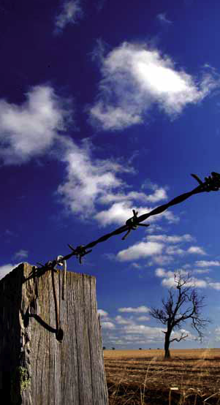
Farmers learn from each other
Most farmers gain, trust and use new knowledge by interacting with other farmers.
The Climate Champions program is about getting farmers to talk to other farmers.
It is about valuing and recognising the knowledge farmer already have.
We want to raise awareness of new tools and practices to manage climate variability and change.
Notes:
The Climate Champion program is all about farmers learning from each other

Slide 21
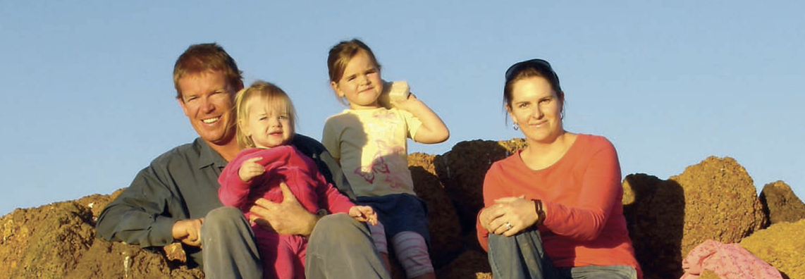
the 34 farmers in the Climate Champions program aim to:
Build farmer networks and communication
Use new tools to manage and adapt to climate variability and change
Gain a even better understanding of the climate
Participate in climate research

Slide 22
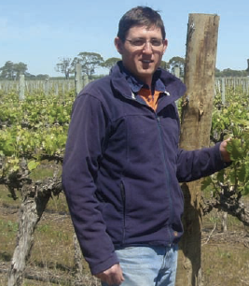
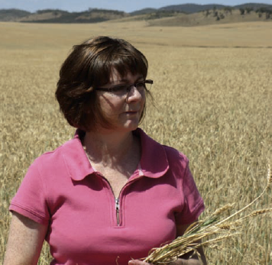
Farmers talking to other farmers
Personally, and at meetings, and field days about climate risk management and ideas for adapting to climate change.

Slide 23
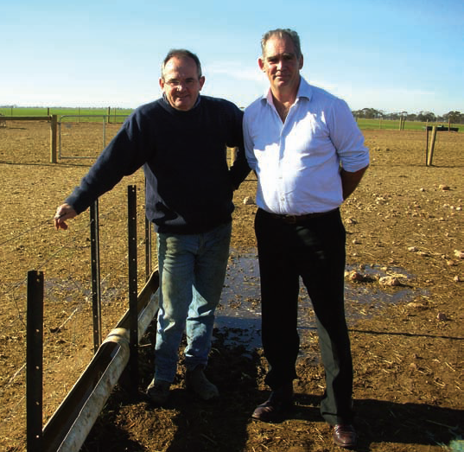
Farmers talking to researchers
the needs of farmers in the region
the success / failures of new tools and practices
research on farms
Notes:
This could also involve things like:
reviewing written material for farmers, like fact sheets
doing interviews for news articles or newsletters

Slide 24
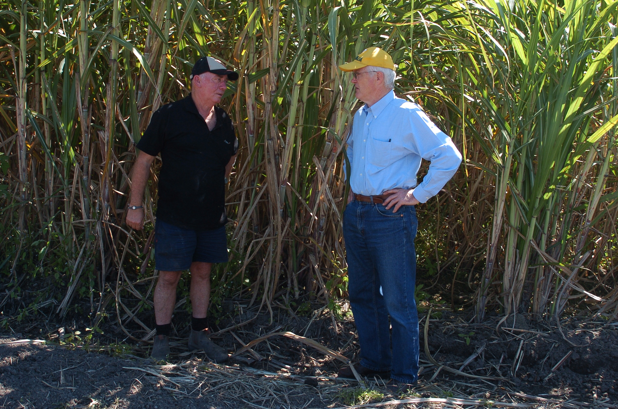
Notes:
Here’s a recent photos of my colleague Toss on the right hand side talking with one of our sugar cane climate champion participants, Robert Quirk on his farm.
Econnect’s role is to provide the Climate Champions with support, organise workshops, and connect them with researchers and other advisors. Recently we ran two-day workshops for them training them in media and presentation skills.

Slide 25
7 top tips
Work with social scientists to better understand the specific groups you wish to communicate with, including current perceptions, attitudes and concerns
Use positive messages and examples to inspire and motivate and to establish positive social norms about both mitigation and adaptation (and avoid messages of fear and guilt)
Use vivid language and images to communicate the concrete nature of climate change
Communicate local / regional examples of changes and actions that are relevant to specific groups
Collaborate with trusted messengers and ‘champions of change’ to engage people in conversations in places where they feel safe
Provide a range of simple and cheap options for behaviour change
Foster two-way communication by involving people and valuing their knowledge

Slide 26
Hot air: communicating the science of climate change
Draft available on Australian Science Communicators’ website:
www.asc.asn.au

Slide 27
The future challenges
To keep supporting the momentum of Climate Kelpie and Climate Champions
To make a difference
To influence governments with evidence-based science to provide the support needed by farmers
Notes:
Our climate change science communication projects with farmers are exciting, but there are still challenges to meet...
And at the end of the day, I am hoping science communication like this will move the politics of climate change back to the science, which can’t be denied.

